Slide 1
Computer Architecture (Fall 2019)
Lecture 13
Pipelining
Dr. Yujuan Tan (谭玉娟)
Office: Main Building 0626
Email: tanyujuan@cqu.edu.cn

Slide 2
Pipeline Terminology
• Fetched instruction
– has been retrieved from the I-Cache
• Decoded instruction
– has completed the ID stage
• Issued instruction
– has been decoded and has started its execution
• in MIPS, it has moved from ID state to EX stage
• Executed instruction
– has completed its execution in the EX stage
• Committed instruction
– is guaranteed to complete
• in MIPS, it has entered the WB stage (or the end of the MEM stage)
and the status vector doesn’t contain any exception flag for it

Slide 3
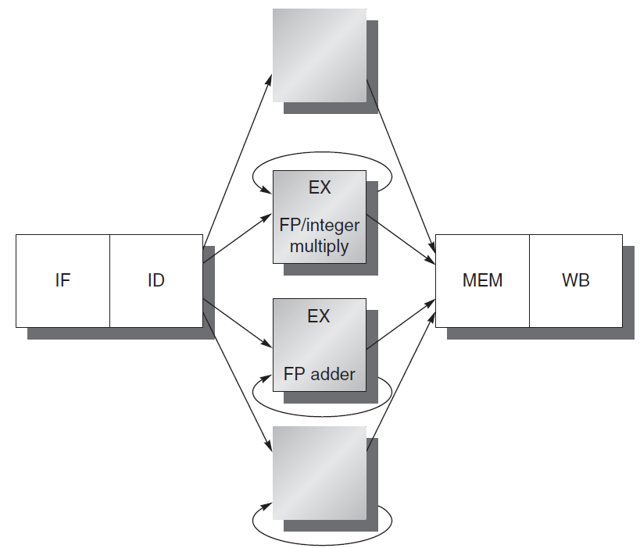
Handling Multi-Cycle Operations in
Pipelined Implementations
• Motivation: Impractical
to require that all FP
operations complete in 1
or 2 clock cycles
– CCT would become too
large
– it would require huge
design costs
• For higher clock rates
– put fewer logic levels in
each pipeline stage
• more pipe stages for
complex operations
• more pipeline registers
necessary
• tradeoff lower CCT vs.
higher CPI
EX
Integer unit
EX
FP/Integer
divider

Slide 4
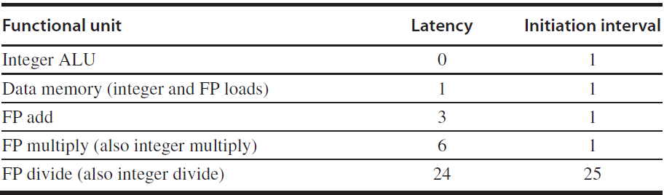
Latency and Initiation Interval
Two important terms of pipelined operations
Latency: the number of intervening cycles between an instruction that produces a result and an instruction that uses the result.
Initiation interval: The number of cycles that must elapse between issuing two operations of a given type.
Since most operations consume their operands at the beginning of EX, the latency is usually the # of stages after EX that an instruction produces a result
Integer ALU operations are all 0;
Loads are 1, since their results can be used after one intervening cycle.
Stores, which consume the value being stored 1 cycle later, are little different. The latency for the value being stored will be 1 cycle less.
Pipeline latency is essentially equal to 1 cycle less than the depth of the execution pipeline, which is the number of stages from the EX stage to the stage that produces the result.

Slide 5
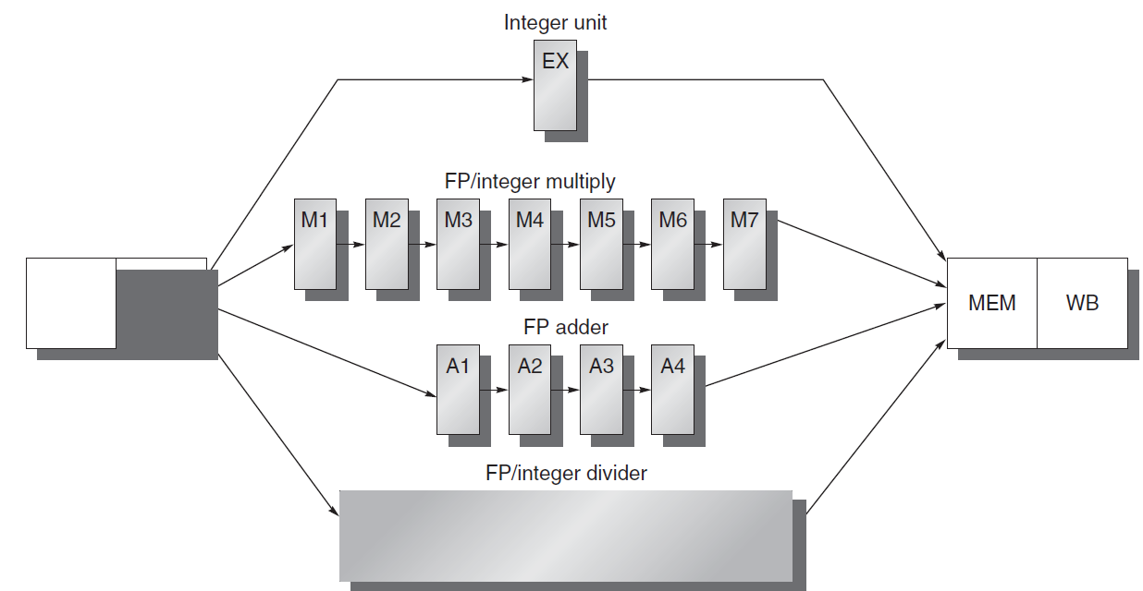
Multi-Stage” vs. “Multi-Cycle” Operations: i.e. Pipelined Stages vs. Sequential Stages
FunctionalUnit | (Additional)Latency | Initiation Interval
IntegerALU | 0 | 1
Data Memory(Int&FP Loads) | 1 | 1
FP Add | 3 | 1
Int&FP Multiply | 6 | 1
Int&FP Divide (SEQUENTIAL!) | 24 | 25

Slide 6
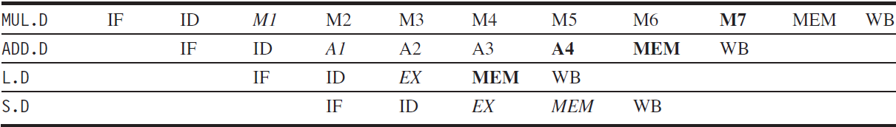
A pipeline supporting multiple outstanding FP operations.
The FP multiplier and adder are pipelined and have a depth of 7 and 4 stages.
The FP divider is not pipelined, but requires 24 cycles to complete.
For example, the 4th instruction after an FP add can use its result without being stalled. Similarly, 7th after an FP multiplier can use its result without being stalled.
Results are ready
Data are needed

Slide 7
Hazards due to Multiple Outstanding
Operations
• Structural Hazards
– sequential (non-pipelined) function units
• e.g., two “close” DIV operations require stalling
– number of register writes per cycle may be larger than 1
• More Frequent RAW Data Hazards
• “instruction y (which follows instruction x in the program order) tries
to read a source register before x writes it”
– longer latency of operations produce more stalls
• Two New Classes of Data Hazards
– WAW
• “instruction y tries to write a destination register before x writes it”
– WAR
• “instruction y tries to write a destination register before x reads it”
• Out-of-order completion
– makes exception handling more complex

Slide 8
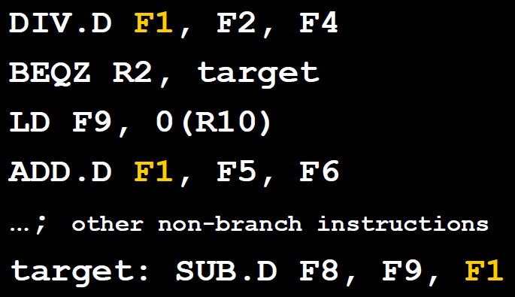
Hazards due to Multiple Outstanding
Operations – Example of WAW Hazard
• WAW
• “instruction y tries to write a destination register before x writes it”
• One may wonder how can WAW hazards occur since it may
seem that a compiler would never generate two writes to
the same register without an intervening read
• However such sequences do occur2,
– e.g., a program may take a path that
the compiler cannot predict, e.g. due
to an intervening branch
• Also, in the case of multiple-issue
pipelines, an intervening read may
be present (and stalled) while the
second write could progress
• In this example if the branch is not taken a WAW if possible when the DIV completes its execution after the BEQZ, LD, and ADD complete theirs

Slide 9
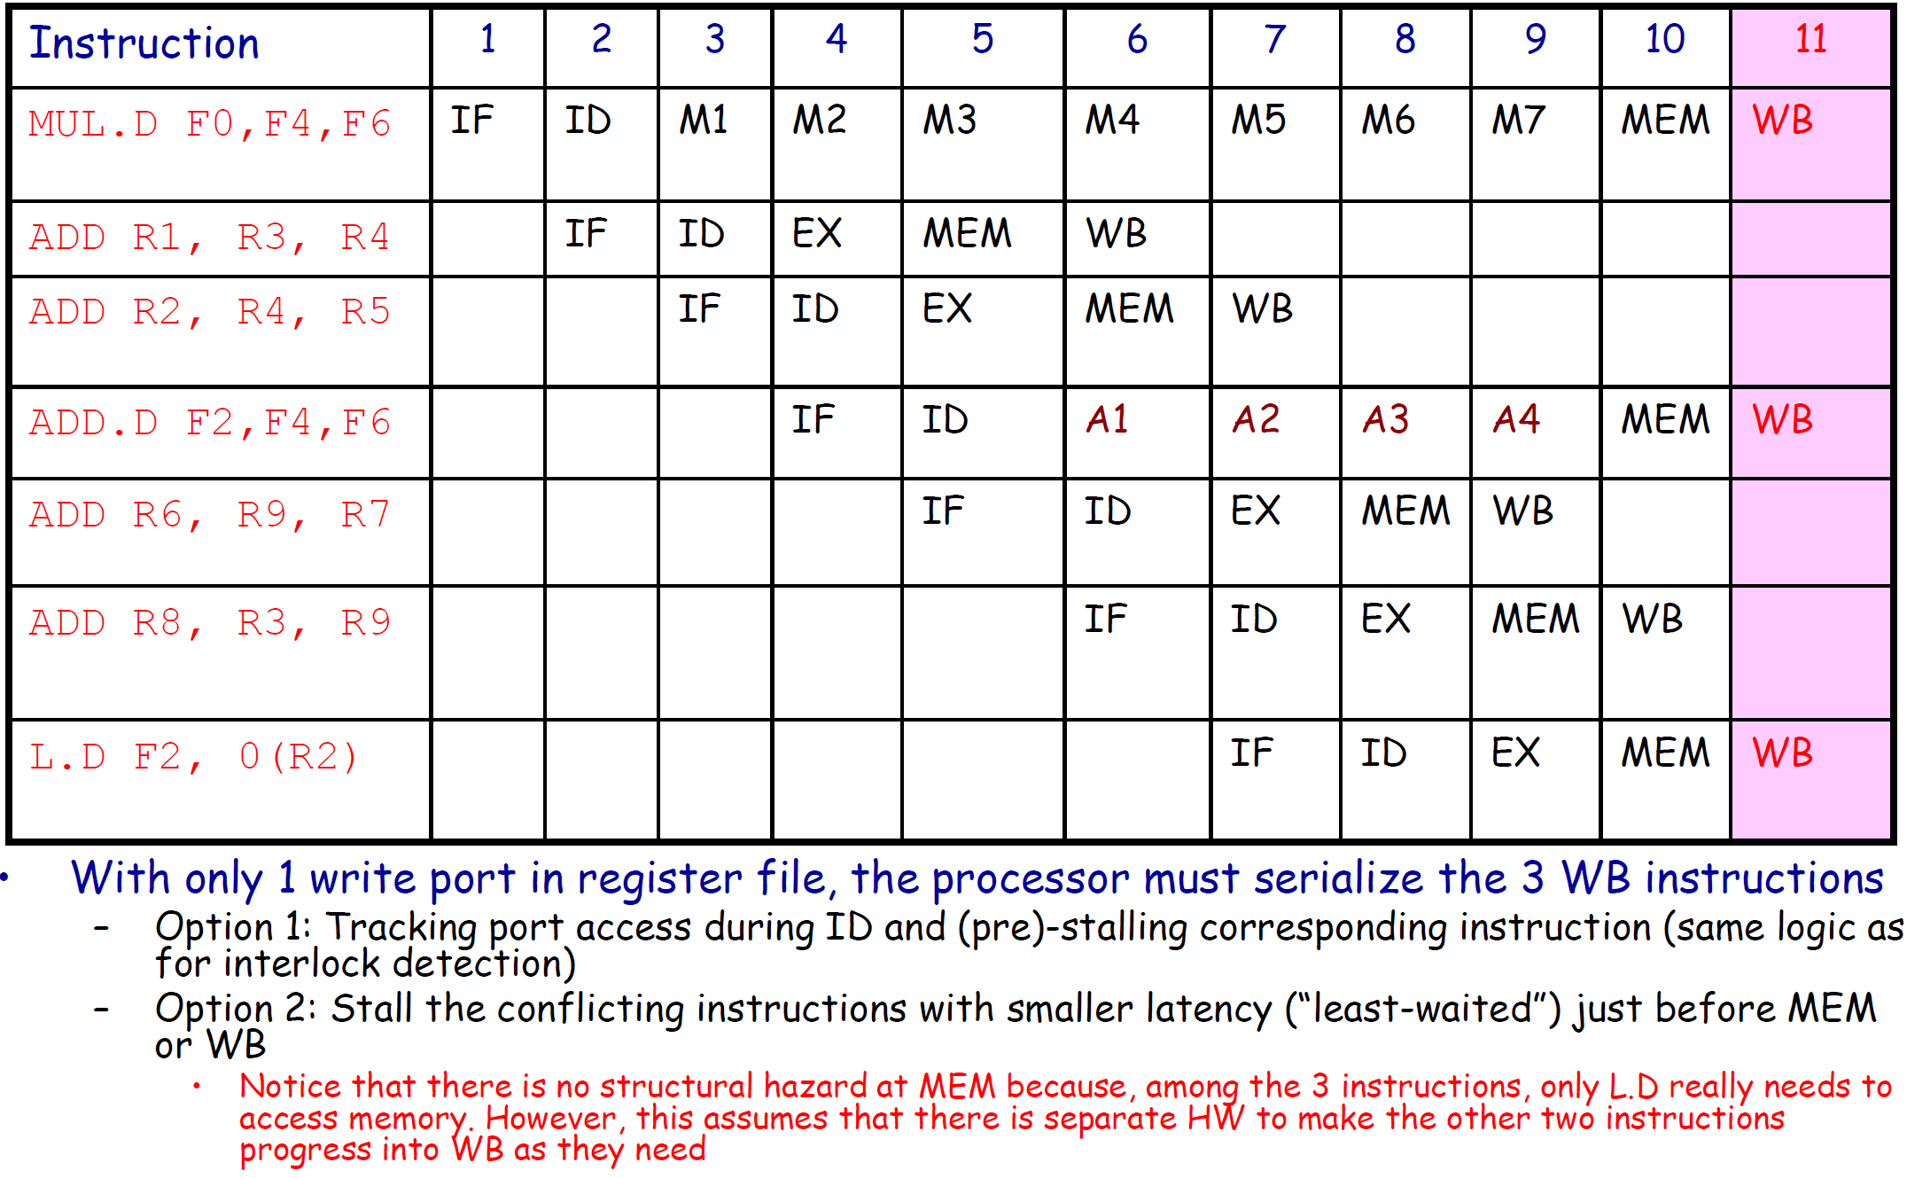
Hazards due to Multiple Outstanding
Operations – Example of Structural Hazard

Slide 10
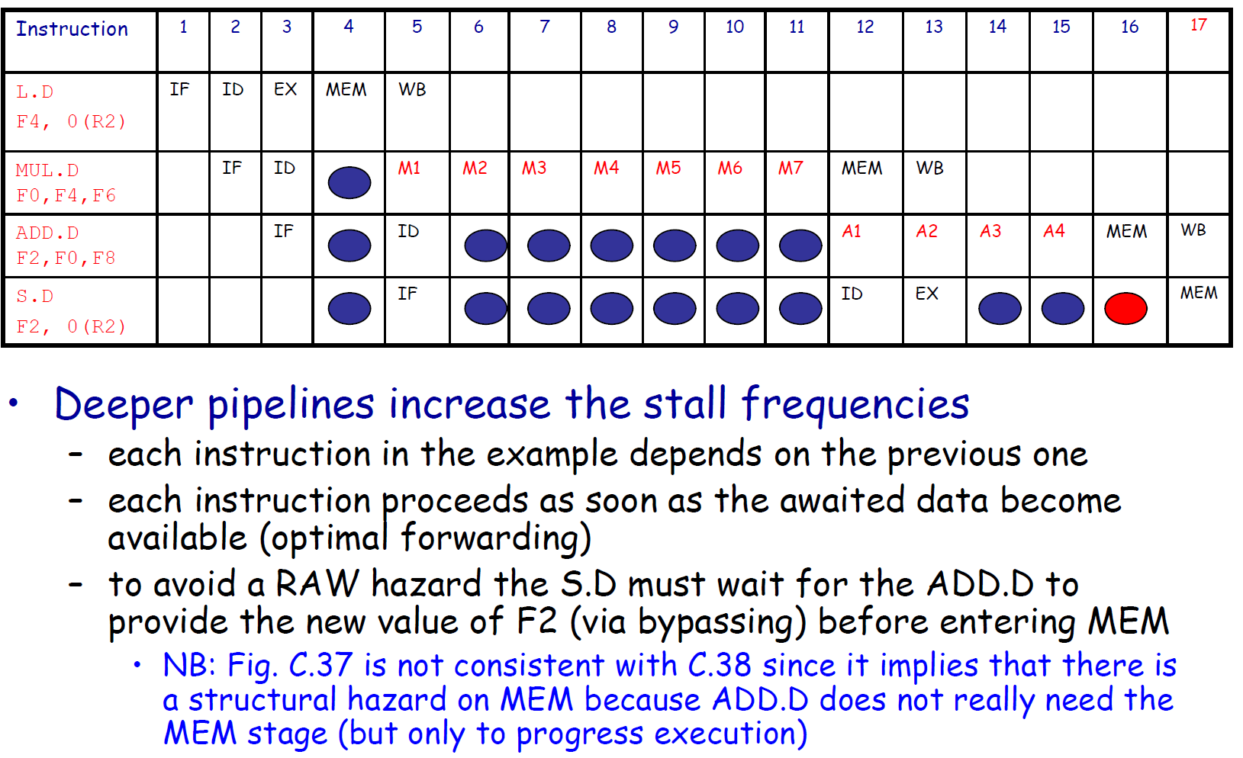
Hazards due to Multiple Outstanding
Operations – Example of RAW Hazard

Slide 11
Hazards due to Multiple Outstanding
Operations – Control Implementation
• Assuming that all hazard detections are done in
ID, before issuing an instruction x we must
– check for structural hazards
• the required function unit must be available (e.g., FP Divisor)
• no future conflicts on the register write port
– check for RAW data hazards
• no conflict between x source register and previous
instruction destination registers
– e.g. if x is a FP operation on F2, check that F2 is not a
destination in ID/A1, A1/A2, A2/A3
– check for WAW data hazards
• no instruction in A1,…,A4, D, M1,…M7 can have the same
register destination as x
• Logic implementation is similar as for the MIPS
integer pipeline

